Slide 1
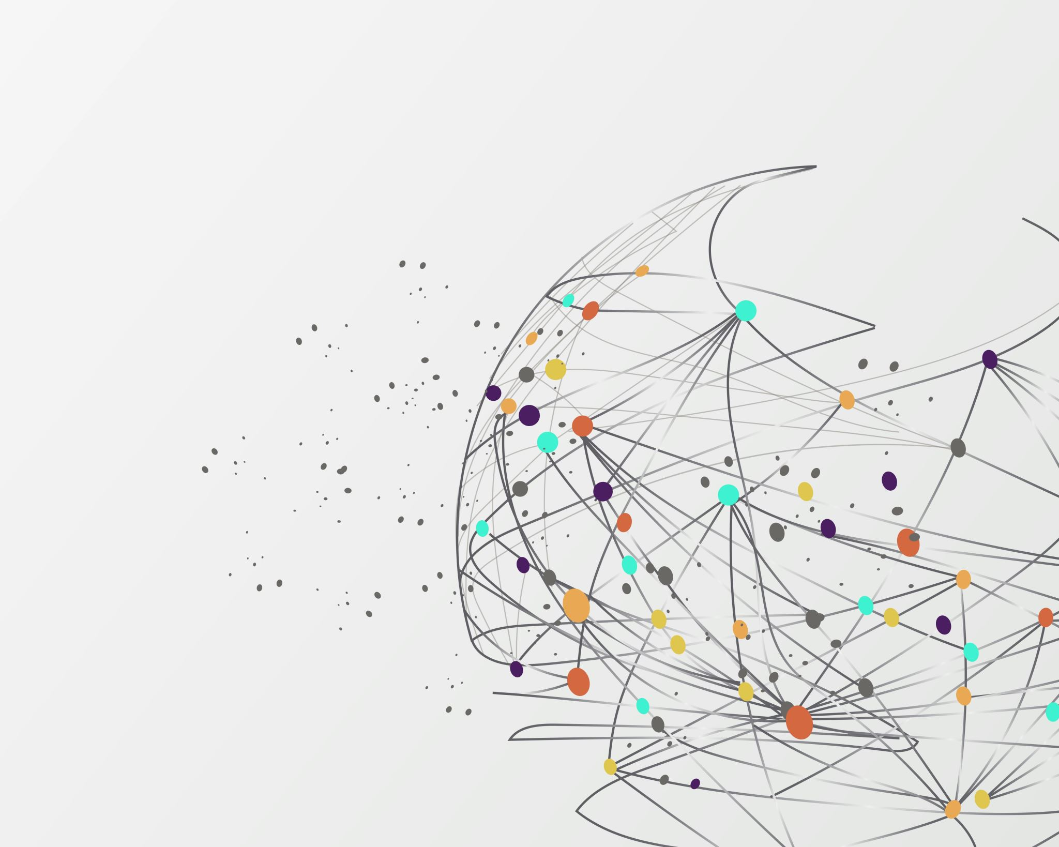
From Data to Decision: Predicting loan defaults with Machine Learning
BY
STRICTLY P.J MCGOVERN II

Slide 2
Outline
Introduction
Uncovering Insights
The Model
Going Live
Action Items
Our Approach

Slide 3

Introduction
About SPJ Savings and Loans: SPJ provides accessible loans to individuals and businesses while maintaining a strong portfolio.
The Challenge: SPJ aims to reduce loan defaults by identifying at-risk borrowers early.
The Dataset: We analyzed borrower data such as income, loan amount, and credit history to find patterns.
Project Objective: The goal is to develop models to predict the likelihood of loan defaults.
The Solution: Machine learning helps identify high-risk loans and optimize lending strategies.

Slide 4
Our Approach
Data Preprocessing
Exploratory Data Analysis (EDA)
Machine Learning Model Development
Machine Learning Model Deployment

Slide 5
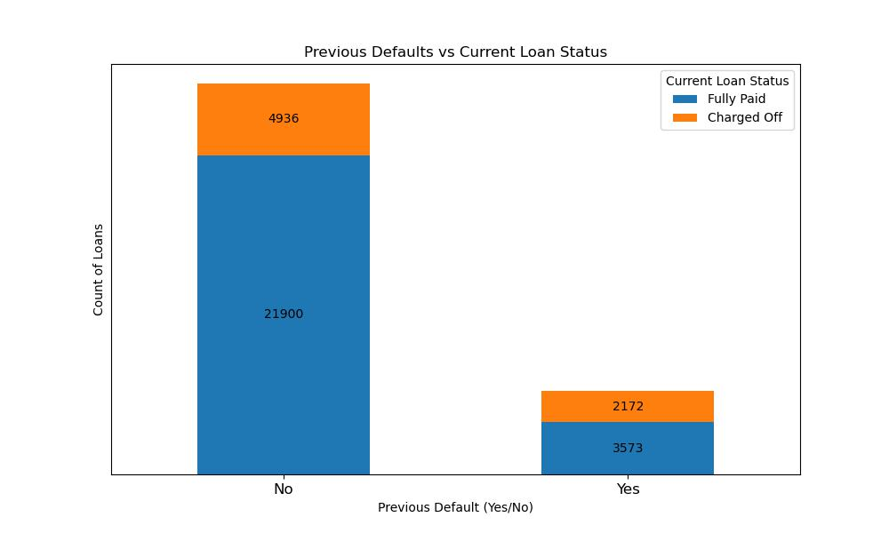
Uncovering Insights
Borrowers with a history of previous defaults are significantly more likely to have their current loans charged off, indicating a strong correlation between past and present loan performance.
If the ratios are compared, loans without defaults have ~4.4:1 success-to-failure rate (fully paid to charged off). Loans with previous defaults show a ratio of ~1.6:1.

Slide 6
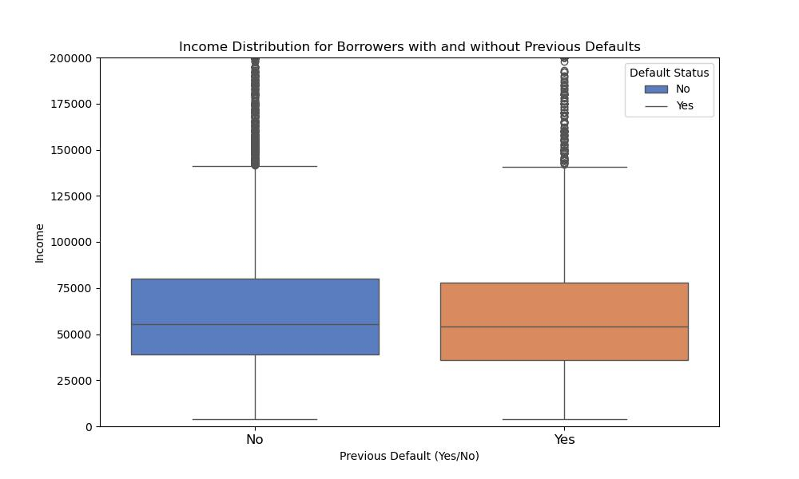
Uncovering Insights Cont’d
Borrowers with previous defaults tend to have lower income levels, suggesting that income is a strong predictor of loan repayment ability.

Slide 7
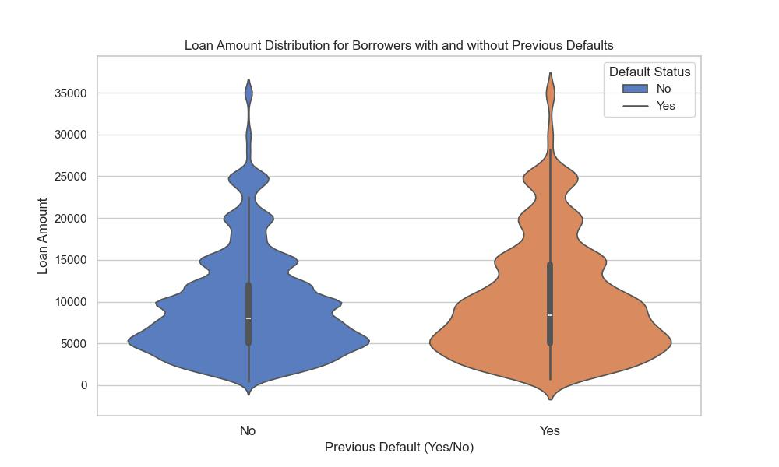
Uncovering Insights Cont’d
Larger loan amounts are associated with a higher likelihood of default, especially among borrowers with a history of previous defaults.

Slide 8

The Model

Slide 9
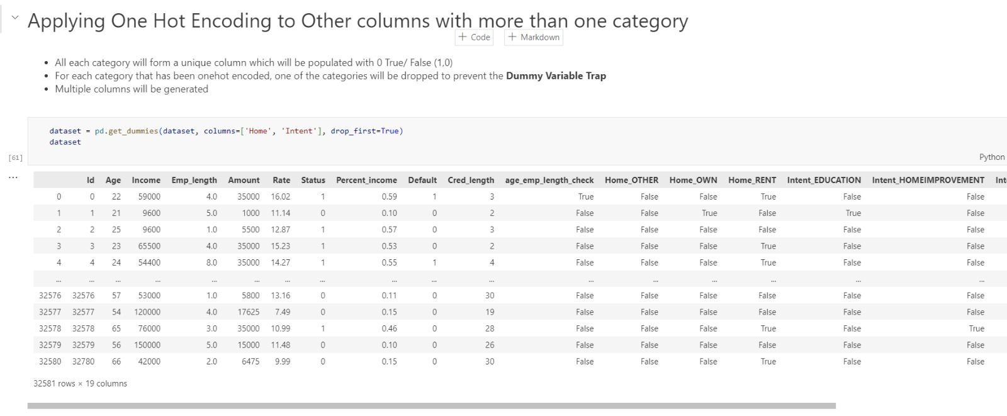
Why
One Hot Encoding?

Slide 10
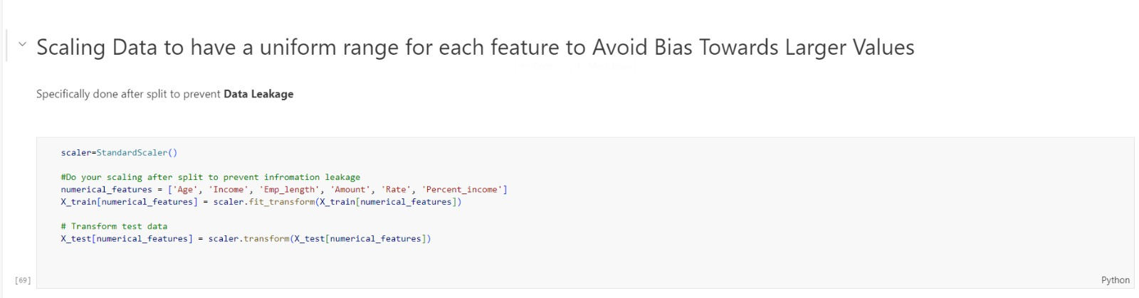
Why
Scaling?

Slide 11
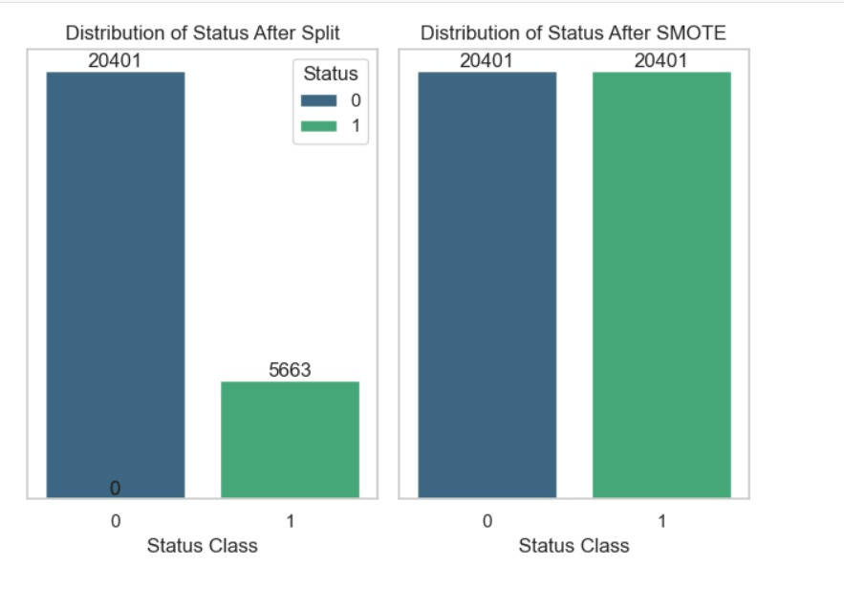
Why
Synthetic Minority Over-sampling Technique (SMOTE)?

Slide 12
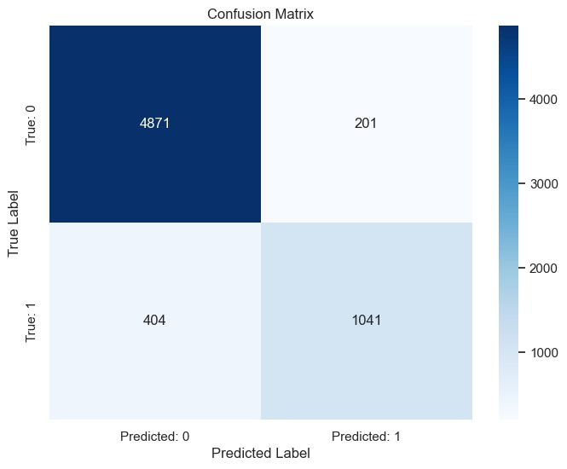
Why
Random Forest?

Slide 13

Going Live
Streamlit Cloud
GitHub
Google Cloud
App link: https://spjsavingsandloans.streamlit.app/

Slide 14
Action Items
Use Previous Default History as a Key Risk Indicator: Weigh past default behavior heavily in the loan approval process and apply stricter conditions for borrowers with a history of defaults.
Implement Risk-Based Interest Rates for High-Risk Borrowers: Adjust interest rates dynamically for high-risk borrowers, ensuring rates reflect their creditworthiness to mitigate default risk.
Offer Lower Interest Rates to Stronger Borrowers: Incentivize borrowers with strong credit and higher income by offering lower interest rates to reduce default risk and attract reliable clients.
Impose Stricter Conditions for Larger Loans: Require additional collateral or stricter approval criteria for larger loans, as they are associated with higher default risk.

Slide 15

THANK YOU

Slide 16

QUESTIONS?

